Slide 1
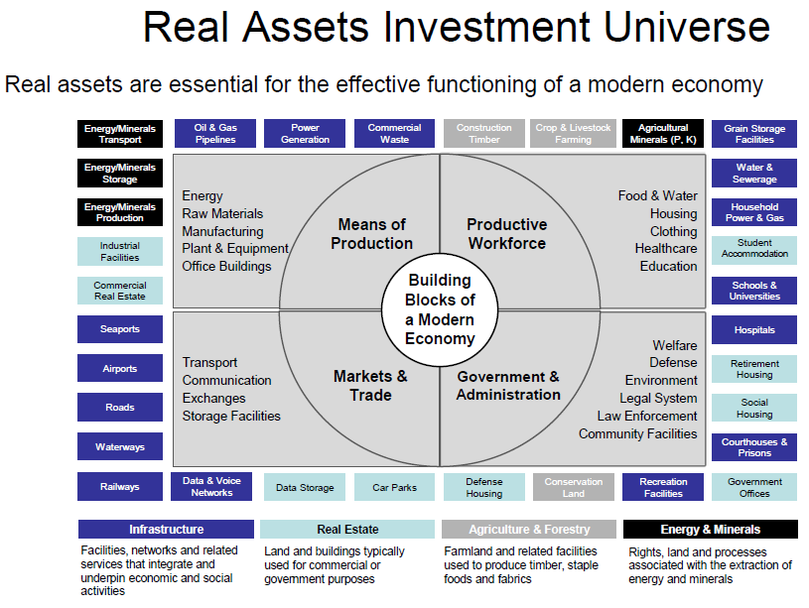
The crude oil and natural gas supply chain

Slide 2
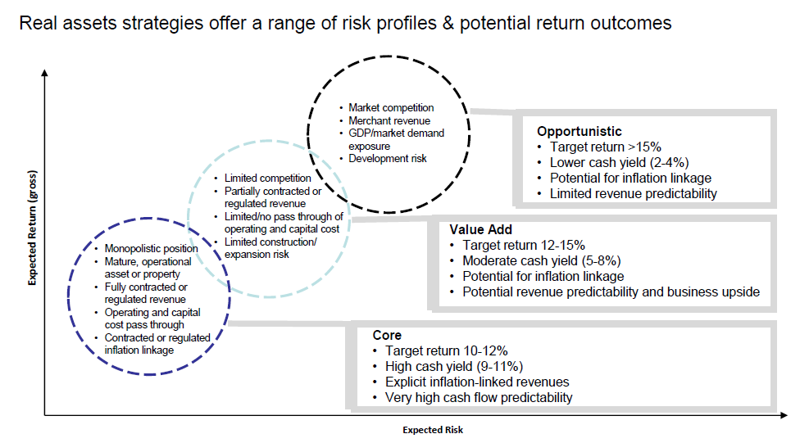
Risk and return do not depend on physical characteristics of an asset

Slide 3
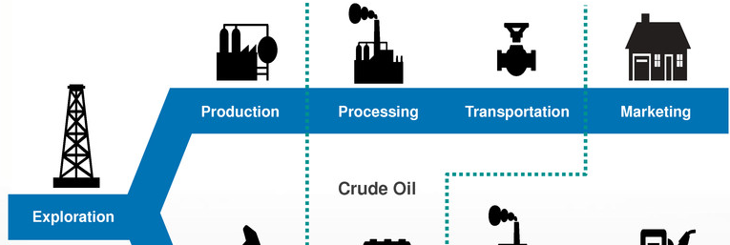

Energy ( oil & gas) supply chain
Natural Gas
Crude Oil
Upstream
Midstream
Downstream
Processing, moving & storing the molecules
Refining and distributing the molecules to the end users
Finding and extracting the molecules

Slide 4
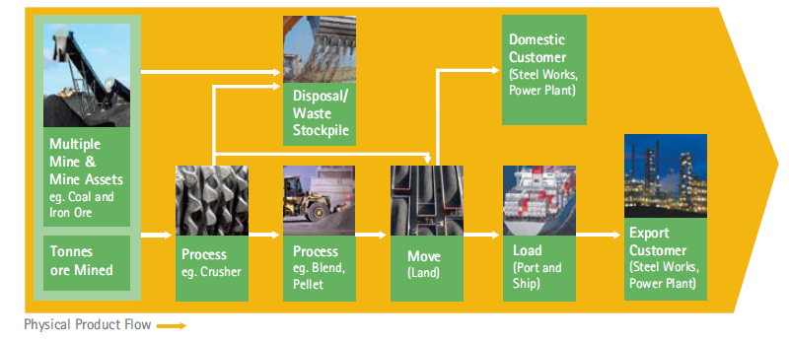
Mining supply chain

Slide 5
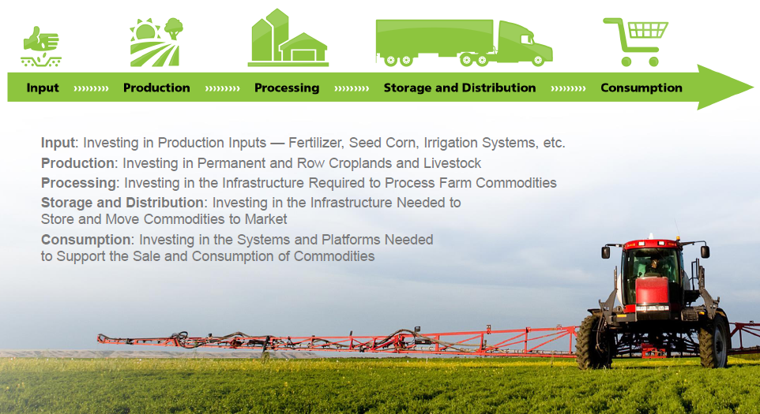
Agricultural supply chain

Slide 6
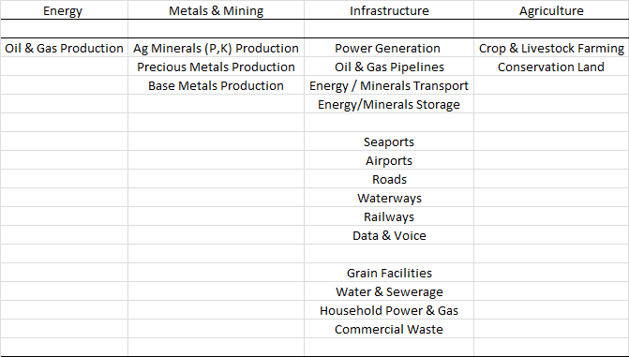
PRIM real asset categories

Slide 7
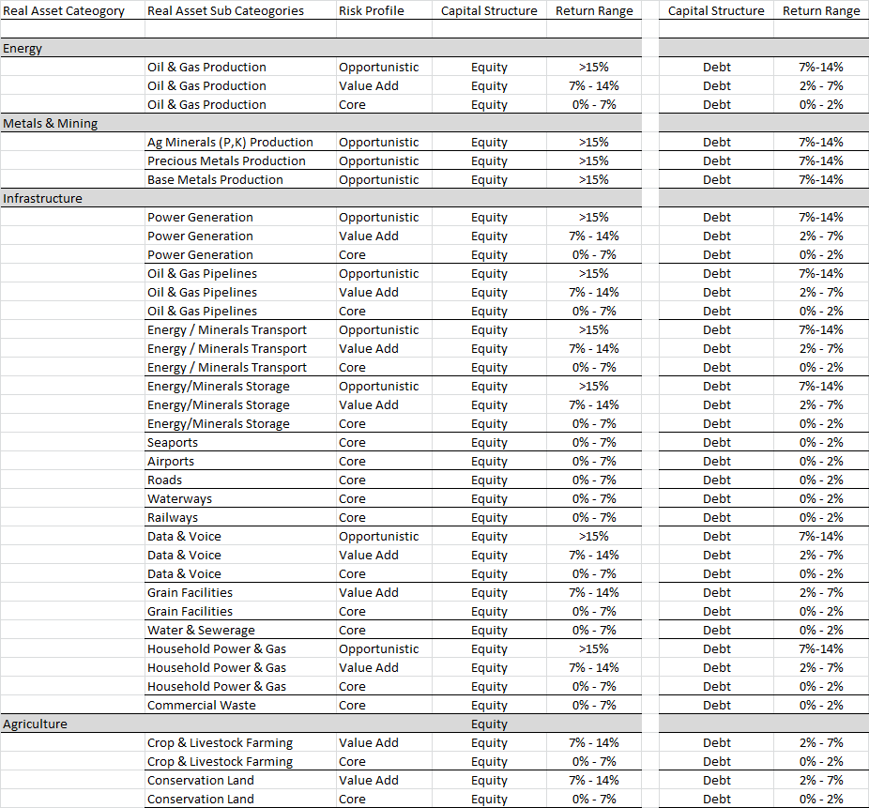
Real asset sub categories risk and return profile

Slide 8
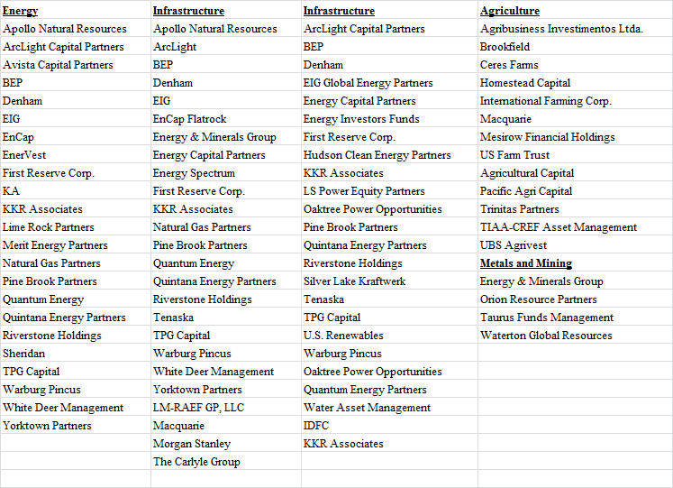
Private Real Asset / Natural Resource Managers

